Slide 1
My Discoveries
Sarah Aisagbon

Slide 2
Question 1
Index Price Forecast

Slide 3
Import Data, Convert to datetime format & set date column as index
import matplotlib
import numpy as np
import openpyxl
import pandas as pd
import sklearn
from matplotlib import pyplot as plt
from numpy import nan
from pandas import read_excel
from sklearn.linear_model import LinearRegression
data_df_raw = pd.read_excel('/Users/sarahaisagbon/Downloads/Question_DataSet.xlsx')
#There are a few missing values. I've observed that the dates are the last day of the month. Assuming that the dates missing are in the right place on the table.
data_df_raw.loc[9, 'Date'] = '2008-01-31'
data_df_raw.loc[130,'Date'] = '2018-02-28'
data_df_raw.loc[131,'Date'] = '2018-03-31'
#some of the entries in the date column are incorrect, but based on the previous assumption I can fix it.
data_df_raw.loc[172,'Date'] = '2021-08-31'
data_df_raw.loc[181,'Date'] = '2022-05-31'
#convert date strings to datetime dtype
data_df_raw['Date']= pd.to_datetime(data_df_raw['Date'])
#set as index
data_df_raw.set_index('Date', inplace=True)

Slide 4
Data Cleaning
#I was initially going to delete the rows with missing values but instead I will get the median value for
#replace nan with mean
data_df_raw.iloc[9,0] = data_df_raw.iloc[8:11,0].median()
data_df_raw.iloc[130,0] = data_df_raw.iloc[129:132,0].median()
data_df_raw.iloc[131,0] = data_df_raw.iloc[130:133,0].median()
#check for 0 in values
df = data_df_raw[data_df_raw.iloc[:,0] == 0]
print(df)
#replace 0 with median
data_df_raw.iloc[41,0] = data_df_raw.iloc[40:43,0].median()
#check if the there are any outliers
df1 = data_df_raw[data_df_raw.iloc[:,0] >= 42]
print(df1)
#I see that 30/04/2019 is 10x bigger than the other values in 2019 so I'll assume the decimal point has been put in the wrong place.
data_df_raw.iloc[144,0] = '19.0475'

Slide 5
Data Cleaning
Initially I was going to replace all nan values with the mean of the column but the mean was much larger and didn’t fir the pattern I had observed.
I noticed that when the data increase it would increase almost linearly and vice versa. So based on this and the fact that there were only three nan values, I decided to find the median of the previous table entry and the next table entry.
Two of the nan values are next to each other so I found the first median by looking at the previous entry and the next non-nan entry. Then for the next nan value I used the value I had just found and the next non-nan entry.

Slide 6
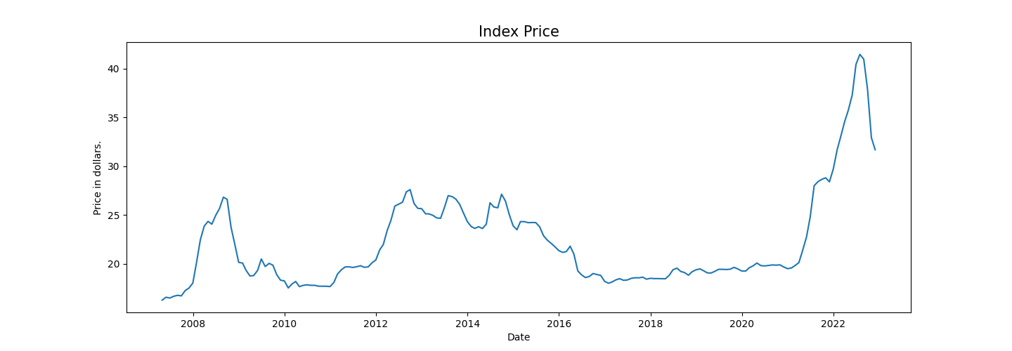
Graph
#plot the data
plt.figure(figsize=(15,5))
plt.plot(data_df_raw['US3387 '])
plt.title('Index Price', fontsize=15)
plt.ylabel('Price in dollars.')
plt.xlabel('Date')
plt.show()

Slide 7
Forecast – Thought process
I first split the data in half – train data and test data.
I then used linear regression and the train data to create a model. An error occurred and I was unable to fix it.
What I was planning on doing was use the model to predict values for the test data and compare it with the actual values to see how accurate the model was. Once I had done this, I would have used the model to predict the next 18 months.

Slide 8
Forecast - Attempt
test_data = data_df_raw.iloc[-94:]
train_data = data_df_raw.iloc[:-94]
x_train = train_data['Date']
y_train = train_data['US3387 ']
x_test = test_data['Date']
y_test = test_data['US3387 ']
np.reshape(x_train, (94,-1))
np.reshape(y_train, (94,-1))
np.reshape(x_test, (94,-1))
np.reshape(y_test, (94,-1))
lr = LinearRegression()
lr.fit(x_train, y_train)
y_pred = lr.predict(x_test)
test_data['y_pred'] = y_pred
print(test_data)

Slide 9
Question 2
Derivative Pricing

Slide 10
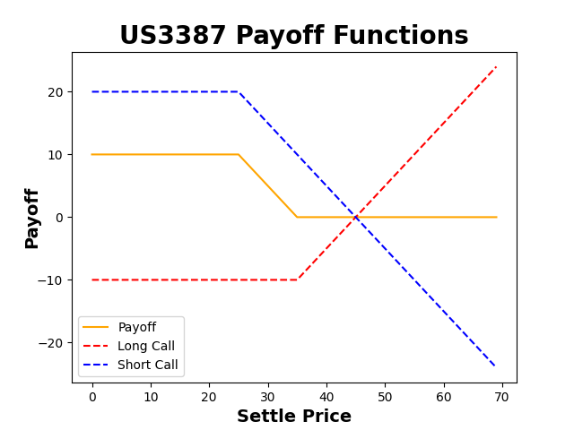
2a & 2b
US3387 is a bear call spread. This means it’s a strategy involving two call options with the same expiration date. The first call option is a short call with strike price of 25 and premium paid for the call is 20. The second is a long call with strike price of 35 and premium paid is 10.
A reasonable premium for US3387 would be at the breakeven point. For US3387, the breakeven point is 35 so a reasonable premium would be $35.

Slide 11
Code
#Question 2 (Derivative Pricing)
# S = stock underlying # K = strike price # Price = premium paid for option
def long_call(S, K, Price):
# Long Call Payoff = max(Stock Price - Strike Price, 0) # If we are long a call, we would only elect to call if the current stock price is greater than # the strike price on our option
P = list(map(lambda x: max(x - K, 0) - Price, S))
return P
def long_put(S, K, Price):
# Long Put Payoff = max(Strike Price - Stock Price, 0) # If we are long a call, we would only elect to call if the current stock price is less than # the strike price on our option
P = list(map(lambda x: max(K - x,0) - Price, S))
return P
def short_call(S, K, Price):
# Payoff a shortcall is just the inverse of the payoff of a long call
P = long_call(S, K, Price)
return [-1.0*p for p in P]
def bear_spread(S, E1, E2, Price1, Price2):
P_1 = long_call(S, E1, Price1)
P_2 = short_call(S, E2, Price2)
return [x+y for x,y in zip(P_1, P_2)]
S = [t for t in range(0,70)] # Define some series of stock-prices
P1 = bear_spread(S, 35, 25, 10, 20)
long_c = long_call(S, 35, 10)
short_c = short_call(S, 25, 20)
plt.plot(S, P1, 'orange')
plt.plot(S, long_c, 'r--')
plt.plot(S, short_c, 'b--')
plt.legend(["Payoff", "Long Call", "Short Call"])
plt.title('US3387 Payoff Functions', fontsize=20, fontweight='bold')
plt.xlabel('Settle Price', ha='center', fontsize=14, fontweight='bold')
plt.ylabel('Payoff', va='center', rotation='vertical', fontsize=14, fontweight='bold')
plt.show()

Slide 12
Disclosure
I have a really bad fever and flu that doesn’t seem to be improving so I decided to do this test now because I thought it was better I submit something than to wait to get better, forget that I have this test to submit and submit nothing.
Apologies, it’s not my best work.

